Slide 1

Predicting the price of a house using machine learning
Ponjesly College Of Engineering
Department Of Computer Science And Engineering
Submitted By
Amaresh
Ahilesh
Abish
Altrin
Gopi Krishna

Slide 2

Predicting the price of a house using machine learning is a complex task that can be affected by several drawbacks and challenges. Overcoming these drawbacks requires a systematic approach and the application of various techniques. Here's a full topic breakdown on how to address the drawbacks in predicting house prices using machine learning:
1. Data Quality and Quantity
2. Feature Engineering
3. Model Selection
4. Overfitting
5. Data Scaling and Normalization
6. Hyperparameter Tuning
7. Evaluation Metrics
1. Data Quality and Quantity:
Drawback: Limited or noisy data can hinder model accuracy.
Solution:
Collect a diverse and comprehensive dataset.
Clean the data by handling missing values and outliers.
Augment data if necessary through techniques like data synthesis or data imputation.

Slide 3
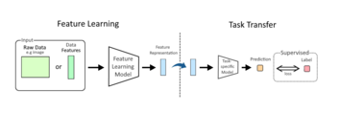
2. Feature Engineering:
Drawback: Insufficient or irrelevant features can result in poor predictions.
Solution:
Carefully select relevant features using domain knowledge.
Create new features through feature engineering to capture hidden patterns.
Use techniques like PCA (Principal Component Analysis) for dimensionality reduction

Slide 4
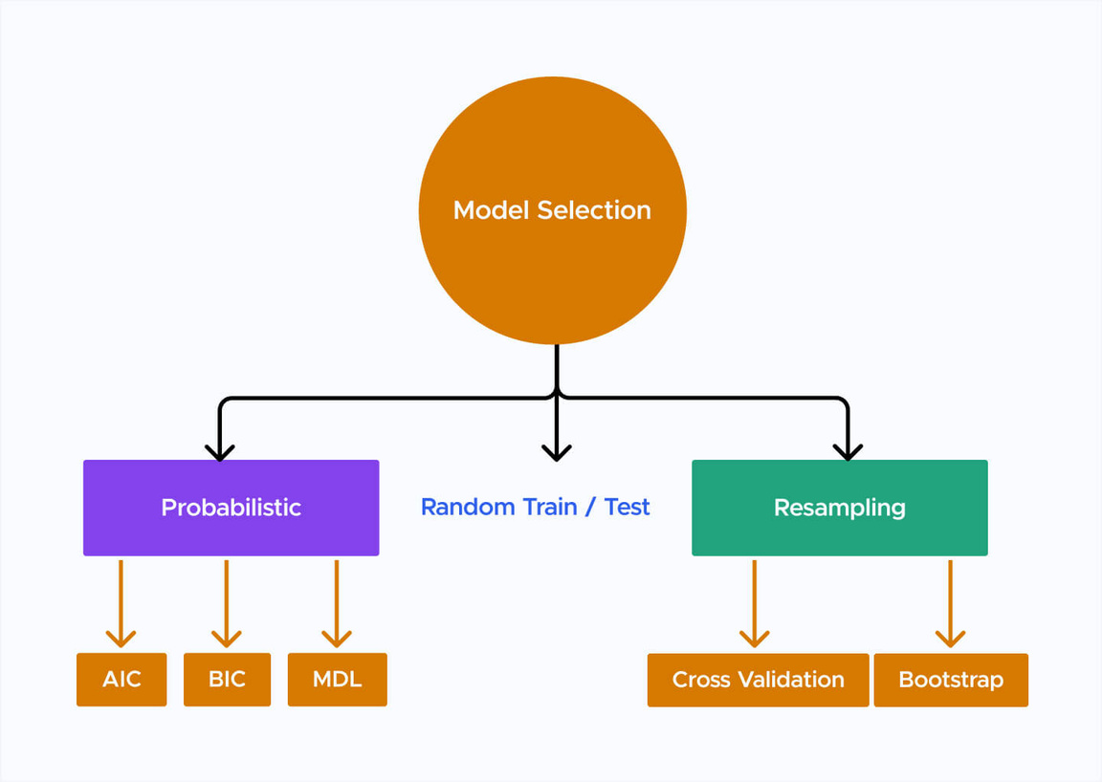
3. Model Selection:
Drawback: Choosing the wrong algorithm or model architecture can lead to poor performance.
Solution:
Experiment with various algorithms, such as linear regression, decision trees, random forests, support vector machines, and neural networks.
Use techniques like cross-validation to evaluate model performance and select the best-performing model.

Slide 5
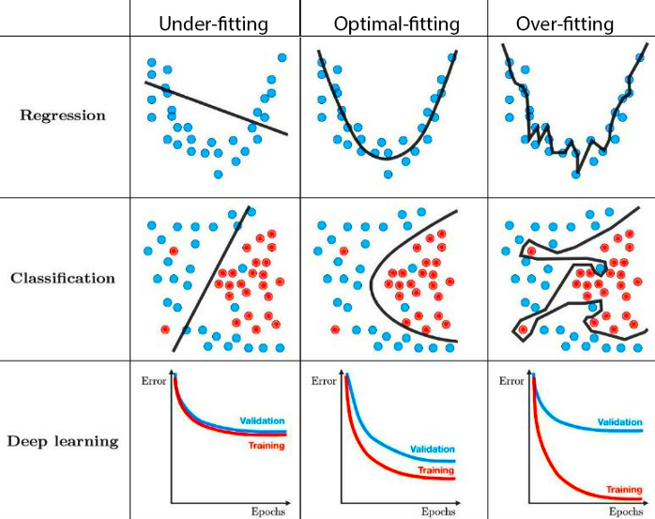
4. Overfitting:
Drawback: Models may perform well on training data but poorly on new data due to overfitting.
Solution:
Regularize models using techniques like L1 or L2 regularization.
Split data into training, validation, and test sets to monitor overfitting.
Use ensemble methods like bagging and boosting to reduce overfitting.

Slide 6
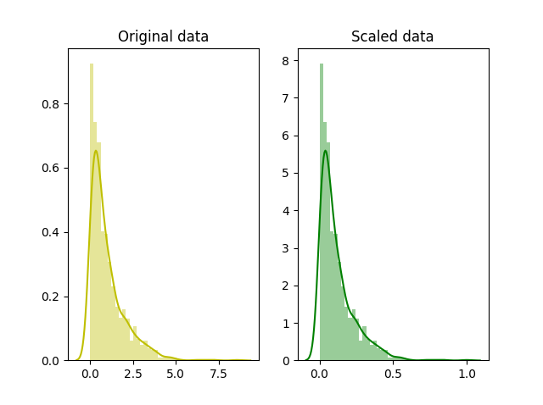
5. Data Scaling and Normalization:
Drawback: Features with different scales can affect model convergence.
Solution:
Standardize or normalize features to have a consistent scale.
Use techniques like Min-Max scaling or Z-score normalization.

Slide 7
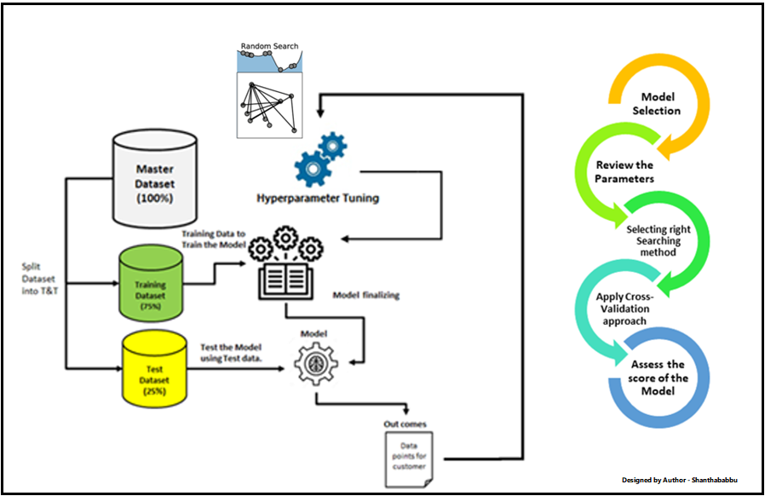
6. Hyperparameter Tuning:
Drawback: Poorly tuned hyperparameters can result in suboptimal model performance.
Solution:
Utilize techniques like grid search or random search to find the best hyperparameters.
Consider using automated hyperparameter optimization tools like Bayesian optimization.

Slide 8
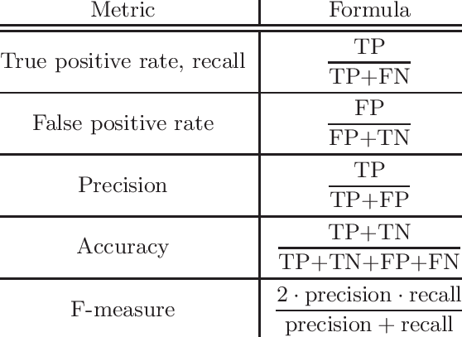
7. Evaluation Metrics:
Drawback: Using the wrong evaluation metrics can misrepresent model performance.
Solution:
Choose appropriate evaluation metrics such as Mean Absolute Error (MAE), Mean Squared Error (MSE), or Root Mean Squared Error (RMSE) for regression tasks.
Consider domain-specific metrics or business objectives when applicable.

